Slide 1
ANALYSIS OF QUADROTOR WITH SLUNG LOAD

Slide 2
Objective
Our aim is to study the dynamics of quadrotor with slung load
To implement a control technique so that quadrotor can go from one point to another in space with minimal disturbance in payload , so we have used a PD control for this purpose.
Analysis of variation of the load angle with respect to length of the rope and load mass.

Slide 3
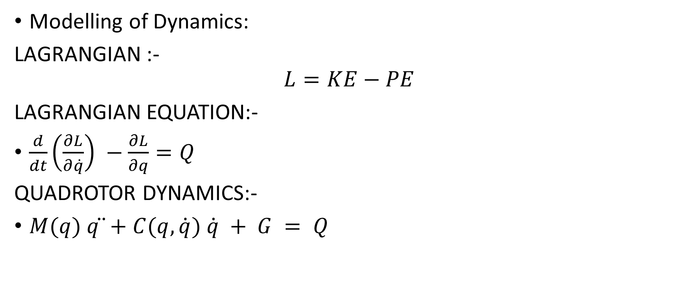
Recap of Phase-I
Modelling of Dynamics:
LAGRANGIAN :-
$$L=KE−PE$$
LAGRANGIAN EQUATION:-
$\frac{d}{dt}\left(\frac{∂L}{∂\dot{q}}\right) −\frac{∂L}{∂q}=Q$
QUADROTOR DYNAMICS:-
$M(q) q ̈+C(q,\dot{q}) \dot{q} + G = Q$

Slide 4



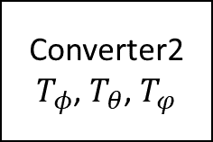




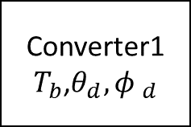












Recap of Phase -I
Control Design:
$$T_{b}$$
$T_{φ}$ $T_{θ}$ $T_{φ}$
$$φ_{d}$$
$$\vec{p_{d}}$$
Position
Controller
Converter1
$T_{b}$,$θ_{d},{φ }_{d}$
$$θ_{d}$$
$${φ }_{d}$$
Orientation Controller
Converter2
$T_{φ}$, $T_{θ}$, $T_{φ}$
Plant Model
$$\vec{\ddot{q}}$$
$$\vec{\ddot{p}}$$
$$\vec{\ddot{η}}$$
$$φ_{a}$$
$$\vec{η_{a}}$$
$${\vec{\dot{η}}}_{a}$$
$${\vec{\ddot{η}}}_{a}$$
$$\vec{p_{a}}$$
$$\vec{\dot{{ p}_{a}}}$$
$$\frac{1}{s}$$
$$\frac{1}{s}$$
$${\vec{\ddot{p}} }_{a}$$
$$\frac{1}{s}$$
$$\frac{1}{s}$$

Slide 5
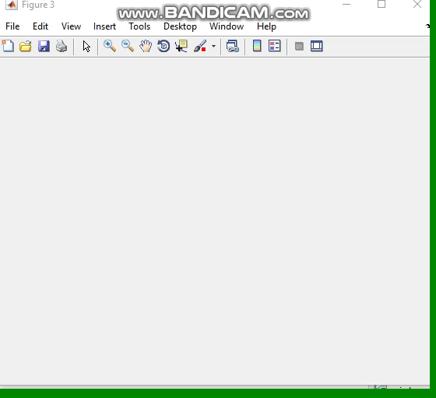
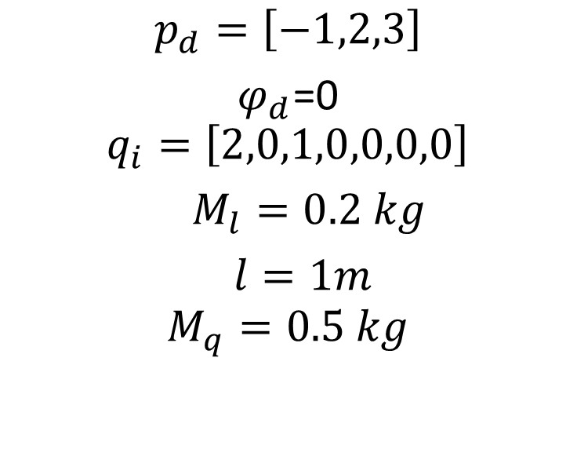
Simulation Result
$$p_{d}=\left[−1,2,3\right]$$
$φ_{d}$=0
$$q_{i}=\left[2,0,1,0,0,0,0\right]$$
$M_{l}=0.2 kg$
$l=1m$
$$M_{q}=0.5 kg$$

Slide 6
Question need to be answer from phase -1
Draw clear image of the quadrotor with slung load?
How load angle changes with respect to load mass and length of rope?
Why lagrangian dynamics is used for finding the dynamics of quadrotor?

Slide 7
+ve Z-axis
X-axis
slung load
Y-axis
-ve Z-axis

Slide 8


Projection of slung load on X-Z plane
Projection of slung load on Y-Z plane
+ve Z-axis
+ve Z-axis
Y-axis
X-axis
$$θ_{L}$$
$$∅_{L}$$
-ve Z-axis
-ve Z-axis

Slide 9
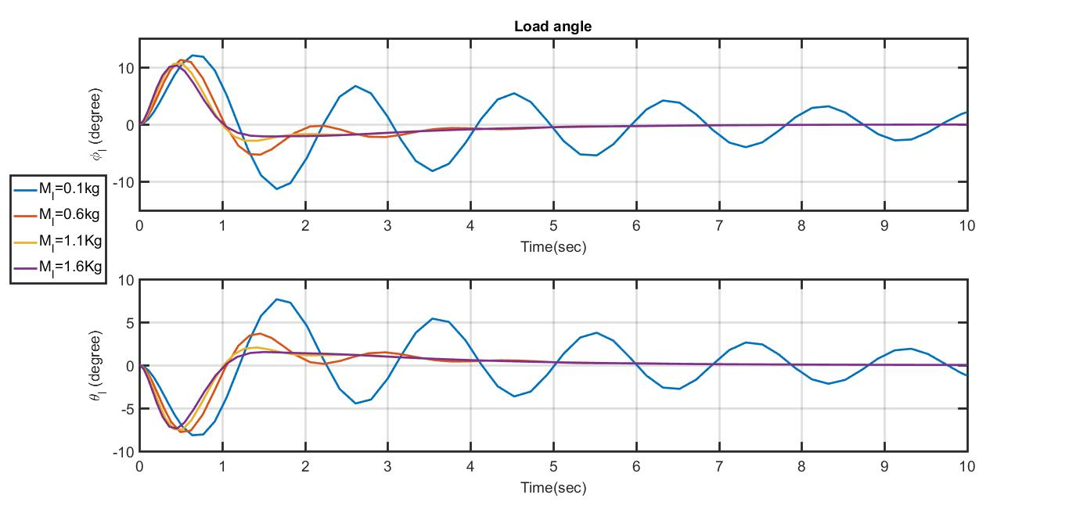
Load angle variation with respect to load mass

Slide 10
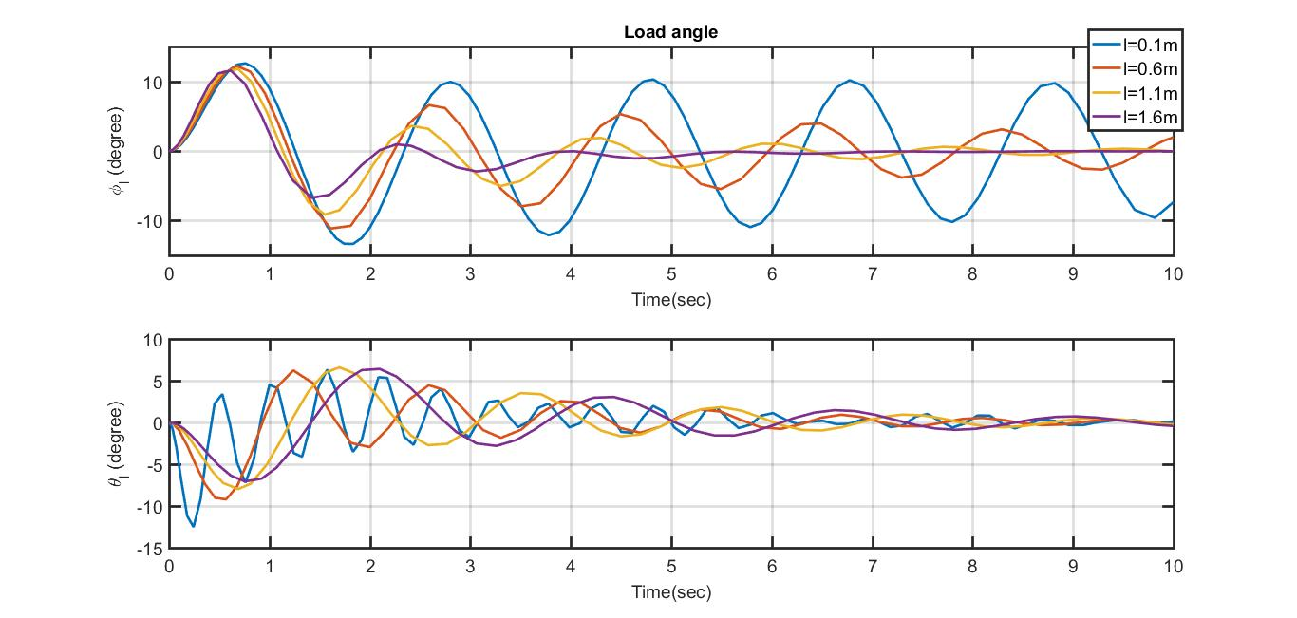
Load angle variation with respect to rope length

Slide 11
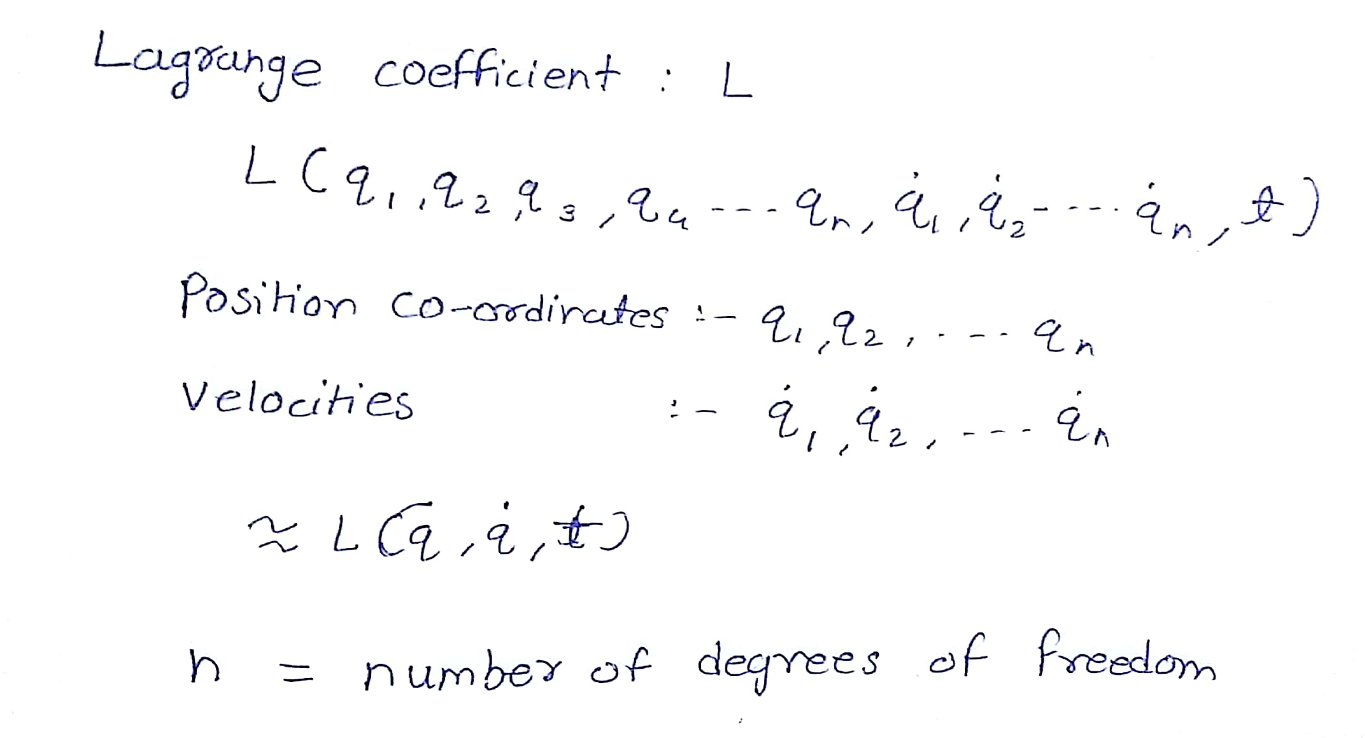

Slide 12

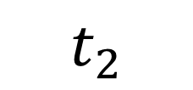
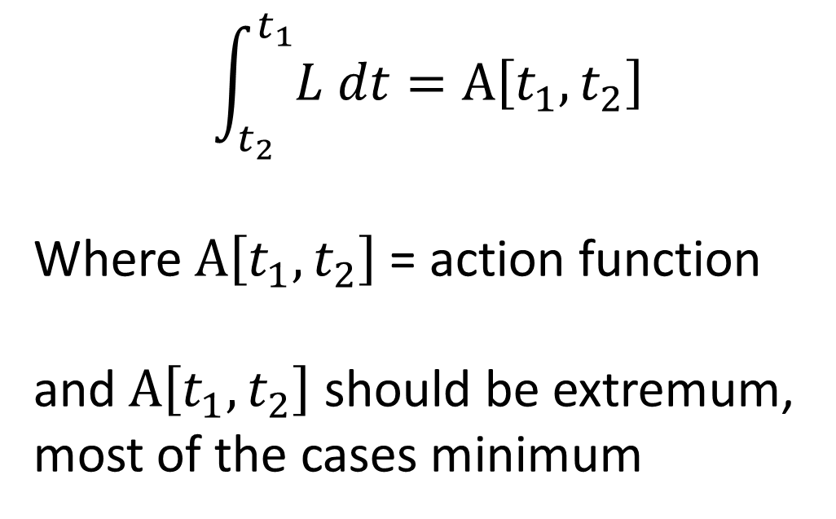
Principal of Least Action
$$t_{1}$$
$$\int_{t_{2}}^{t_{1}}{L dt}=A\left[t_{1},t_{2}\right]$$
Where $A\left[t_{1},t_{2}\right]$ = action function
and $A\left[t_{1},t_{2}\right]$ should be extremum,
most of the cases minimum
$$t_{2}$$

Slide 13
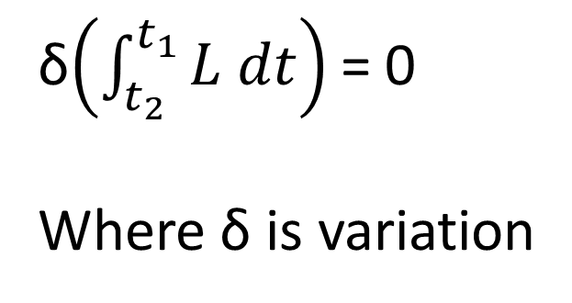
Principal of Least Action
$$t_{1}$$
δ$\left(\int_{t_{2}}^{t_{1}}{L dt}\right)$ = 0
Where δ is variation
$$t_{2}$$
Considering all variations choose a path such that action is minimum,
This is Principal of Least Action

Slide 14
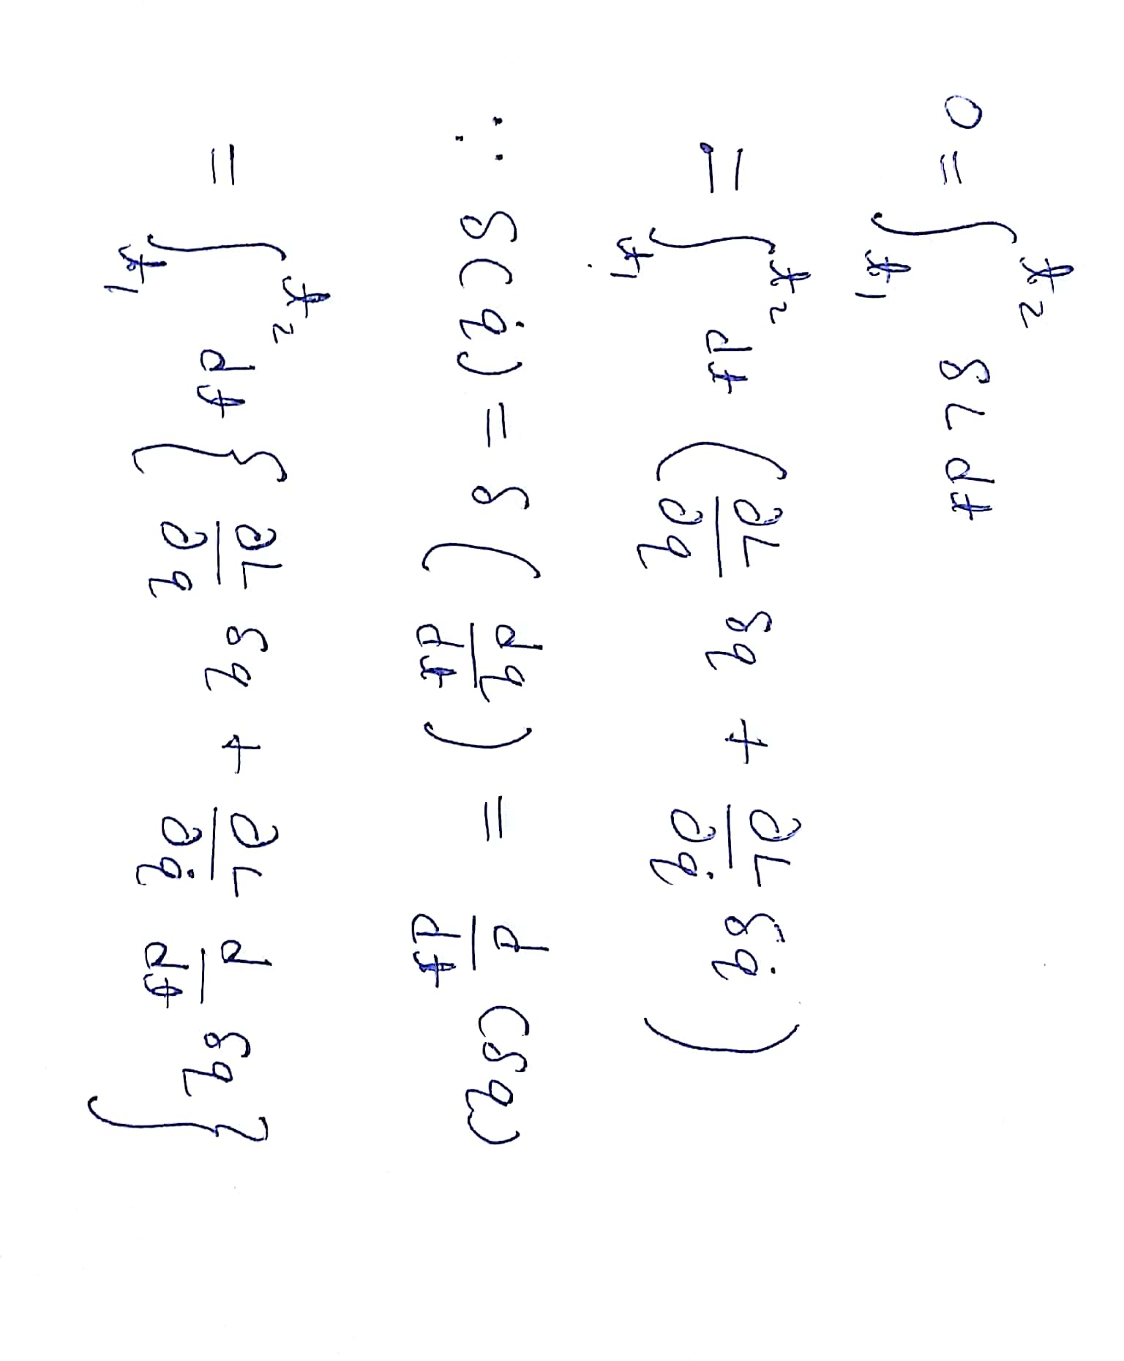

Slide 15
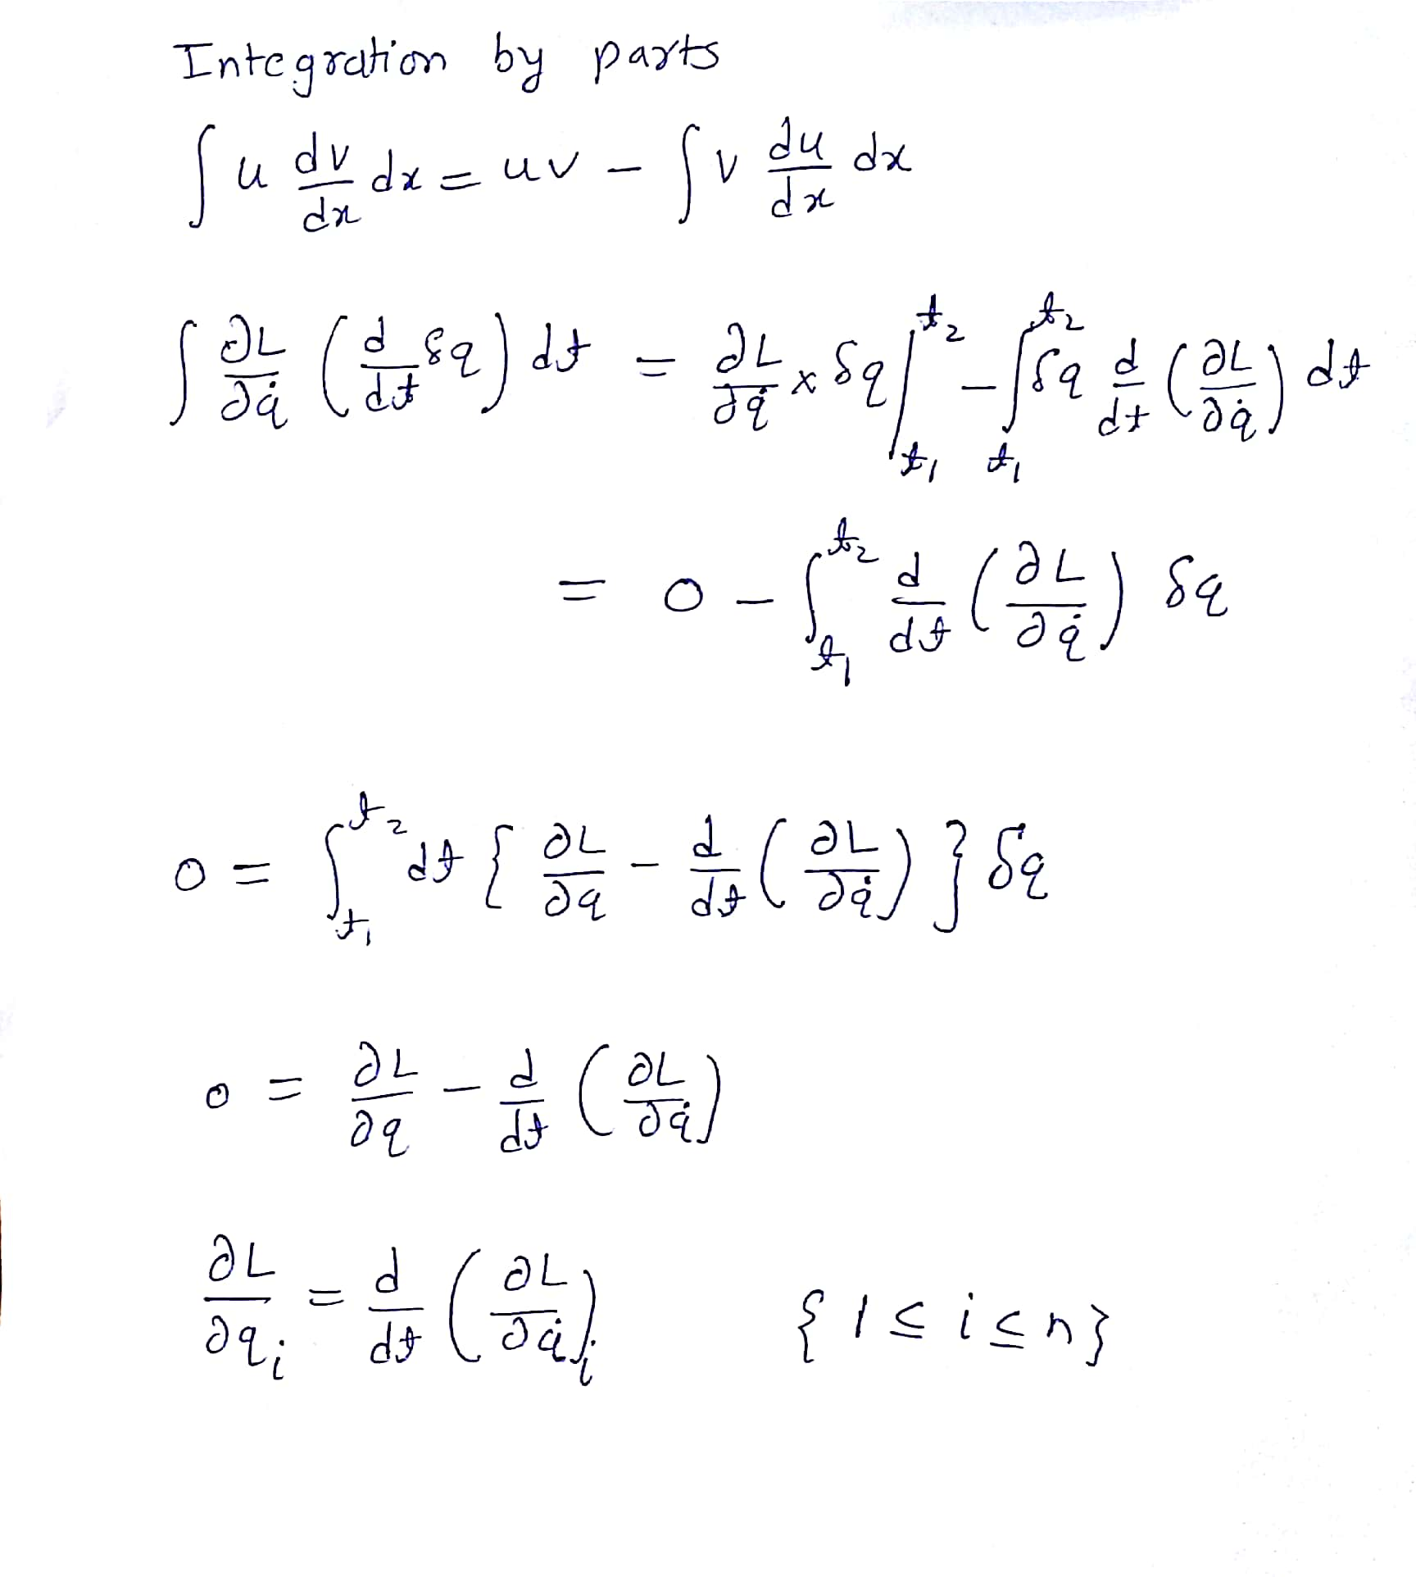

Slide 17
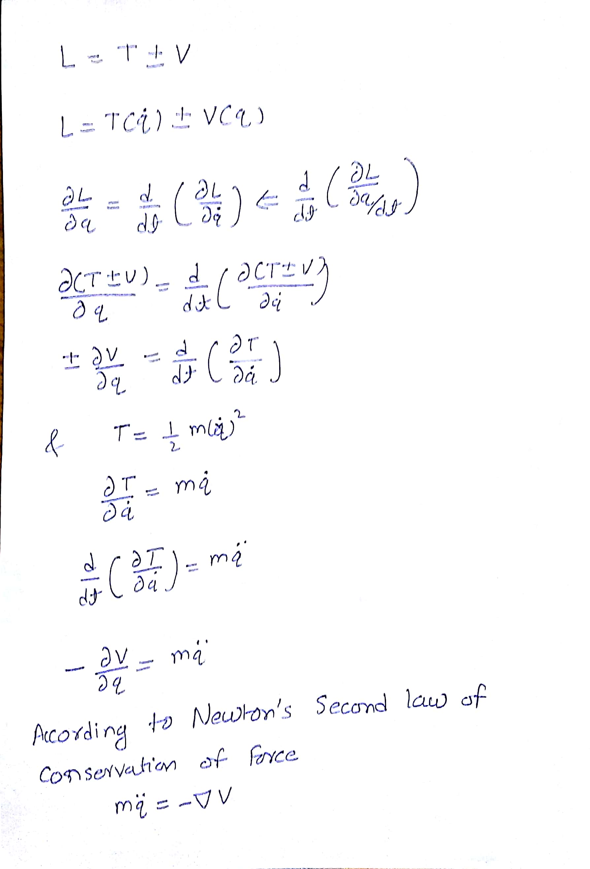
Why Lagrange coefficient = KE - PE

Slide 19
THANK YOU

